Slide 1

Wild Wood Apartments DBMS Proposal
Allyssa Evergreen
IT-650 Database Presentation
Notes:
Notes
Type in something

Slide 2
Wild Wood Apartments Database Proposal
Organization
Database Analysis and Design
DBMS
Data Model
Laws, Ethics, and Security

Slide 3
Organization The Wild Wood Apartments

Slide 4
Organization – The Wild Wood Apartments
Pain Points with Current Process
Data is manually entered and managed
Increases turnaround times, waits, and promotes inefficiencies
Insecure and inefficient storage of Documents and Receivables
Notes:
Data is manually entered and managed
Stakeholders impacted by this are:
Apartment Managers
Corporate Managers
Tenants
Increases turnaround times, waits, and promotes inefficiencies
Apartment Managers must:
Manually enter all data
Review physical documentation
All physical documentation is then translated into a quarterly report for HQ
Complete quarterly reports that take a long time
Corporate Managers must wait until all quarterly reports are submitted
Due to crunch times and inefficient documentation, most reports must be re-submitted due to missing or inefficient data
Insecure and inefficient storage of Documents and Receivables
Stored in physical envelopes or placed on desks
No strict guidelines on how to store this information, posing potential data security and safety concerns
No current management system to organize all this information

Slide 5
Database Analysis and Design

Slide 6
Database Analysis and Design
Physical Design of Wild Wood Apartments Database
Uses Microsoft’s Structured Query Language (SQL) Server Management Studio
Data Types are pre-determined and strict based on the business need.
Example: Employee ID.
Data Types: Requirements vs. Nulls.
Promotes a Relational Database Management System
Primary and foreign keys
Example: All relevant repairs completed in a single Apartment Unit.
Query Capabilities
View, select, edit, delete, joins
Notes:
Uses Microsoft’s Structured Query Language (SQL) Server Management Studio
Microsoft SQL is a common database language and program used by many enterprises
Capable of customizing the program to best-fit Wild Wood Apartments’ needs.
Microsoft SQL is a relational database management system
Data types (such as characters and numbers) can be pre-determined and strict based on the need.
For example, if a user inputs an Employee ID, all Employee IDs at Wild Wood Apartments are only 4 digits long and are letters and numbers.
Data and fields may be listed as required and/or allow nulls
If field(s) listed as required – and do not allow nulls – the data entry will not be submitted.
If the field(s) allow for nulls, the data entry will bypass this requirement.
Promotes a Relational Database Management System
Organizes data in terms of relationships
Primary and foreign keys pairings are used to ensure data relationships.
For instance, if a repair transaction is inserted into the database, it is required to add the Apartment ID that the repair was completed for/in. The Apartment ID and Repair ID in the transaction are both primary keys in their table, but also foreign keys in each of their own tables. If we ran a query to pull all repairs completed in the Apartment Unit with the corresponding Apartment ID of our choice, it will pull all relevant and pertinent repairs completed in the Apartment Unit.
Query Capabilities
View. Returns specific data that is accessible to the user.
Select. Directs which database data should be collected and selects specific table(s) necessary for the user.
Edit. Allows the user to edit the information.
Delete. Deletes the table and data from the database.
Joins. Customizes how the data is displayed to the user.

Slide 7
Database Analysis and Design
Physical Design of Wild Wood Apartments Database (cont.)
Entities within the Database System
Apartment Complex
Apartment Units
Lease
Receivables
Vendors
Employees
Notes:
Entity: Apartment Complex
Attributes:
AptComplex_ID, Lease_ID, Employee_ID, AptComplex_Name, Address, City, State, Zipcode, Phone.
Entity: Lease
Attributes:
Lease_ID, AptComplex_ID, AptUnit_ID, Lease_Status, Tenant Name, Tenant_Contact_Information, Start Date, End Date, Rent_Amount, Deposit, Lease_PDF, Confidentiality_Release_PDF.
Entity: Vendors
Attributes:
Vendor_ID, Company_Name, Company_Contact_Info, Company_Email, Employee_Name, Address, City, State, Zipcode.
Entity: Apartment Units
Attributes:
AptUnit_ID, AptComplex_ID, Lease_ID, Number_of_Bedrooms, Number_of_Bathrooms, Floor
Entity: Receivables
Attributes:
Receiveable_ID, AptComplex_ID, AptUnit_ID, Vendor_ID, Payment_Status, Date_Service_Started, Problem, Receivable_Type, Resolution, Date_Resolution, Repair_Status, Amount, Receipt_PDF
Entity: Employees
Attributes:
Employee_ID, AptComplex_ID, EE_Status, Name, Position, Address, City, State, Zipcode, Wages

Slide 8
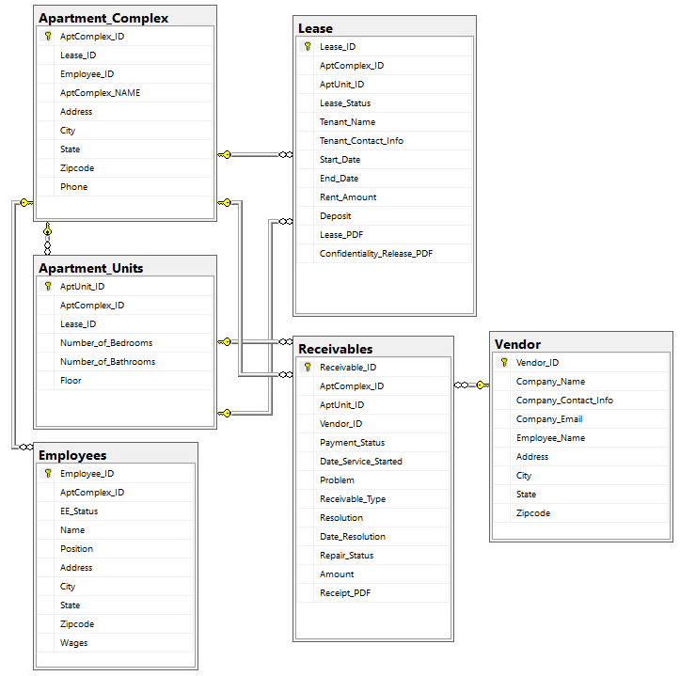
Database Analysis and Design
Physical Design of Wild Wood Apartments Database (cont.)
Notes:
The physical design displays all the primary keys within each entity as well as the relationships between each entity.
Relationship types:
One-to-Many. For every entity, there are many transactions or instances of the entity.
One-to-One. For every one entity, there is an equal one entity.
Many-to-Many. There can be many entities to many entities.
Entity: Apartment Complex
Relations:
One-to-Many (Lease, Receivables, Apartment Units, Employees)
Entity: Lease
Relations:
Many-to-One (Apartment Complex, Apartment Units)
One-to-Many (Receivables)
Entity: Vendors
.
Relations:
One-to-many (Receivables)
Entity: Apartment Units
Relations:
Many-to-One (Apartment Complex)
One-to-Many (Lease, Receivables)
Entity: Receivables
Relations:
One-to-One (Receivables)
Many-to-One (Apartment Complex, Apartment Units)
Entity: Employees
Relations:
Many-to-One (Apartment Complex)

Slide 9
Database Management System (DBMS)

Slide 10
Database Management System
Recommended leading DBMS products
Microsoft SQL Server (with Amazon RDS)
Common SQL application
Database Management assistance
Oracle Autonomous Database with Oracle Cloud Interface (OCI)
Zero-data-loss architectures
Layers of resilience
IBM Db2 on Cloud
Both on-premises and/or cloud-hosted
AI-powered capabilities to manage unstructured and structured data
Hybrid connection that supports self-service, scaling, and DEV/TEST turnaround times
Notes:
Microsoft SQL Server (with Amazon RDS)
Common SQL application
Microsoft SQL is a common program that is known with many database administrators as well as enterprises.
The SQL server database engine handles data processing, storage, and database security.
Database Management assistance
Amazon contains an Amazon RDS team that provides database management assistance to customers.
Services include: software patching, setup, backups, configuration, or hardware provisioning.
Application to Wild Wood Apartments
Queries may be ran to obtain data based on specific relationships, such as the repairs completed in a specific apartment.
With additional training, responsibility may also shift to financial accountant or record keeper at company HQ.
Main weakness: multiple queries may need to run to complete necessary reports.
Oracle Autonomous Database with Oracle Cloud Interface (OCI)
Zero-data-loss architectures
Oracle prides itself in never losing data and its ability to scale performance and storage capacity when compared against other competitors.
For instance, this program is able to handle millions of input/ouput operations per second and with usable capacities of 340 terabytes.
Layers of resilience
Resilience refers to consistent protection and policy-based backups
Allows for fast connectivity and industry-first services
Application to the Wild Wood Apartments
The Oracle DB allows storage of a massive amount of data, records, and documents within the DB.
Scalable for larger operations and could be used for future growth in the company.
Main weakness: more expensive than other competitors
IBM Db2 on Cloud
Both on-premises and/or cloud-hosted
IBM’s DB are accessible in physical environments as well as in the cloud environment, promoting less downtime should anything occur.
AI-powered capabilities to manage unstructured and structured data
AI-powered capabilities manage data across various environments for an additional security layer and resilience.
Hybrid connection that supports self-service, scaling, and DEV/TEST turnaround times
The DB is able to access information through the cloud, but also retains personally identifiable information (PII) on physical systems.
Offsite nodes help ensure availability and resiliency for disaster recovery efforts
IBM also contains a 24/7 team dedicated to operating systems, security patches, data protection, and data encryption
Application for the Wild Wood Apartments
Operates similar to the Microsoft SQL server and is easy-to-use.
The IBM Db2 on Cloud is a pay-as-you-go model and is scalable to meet the Wild Wood Apartments needs.
There is a 24/7 team dedicated to maintaining necessary updates and certifications, while also available for assistance with DB management functions.
Accessible to users at anytime with its hybrid connection.
Main weakness: once enterprise becomes larger, the cost may be expensive for Wild Wood Apartments.

Slide 11
Database Management System (DBMS)
Best DBMS Product for Wild Wood Apartments
IBM Db2 on Cloud
Hybrid connection
Smart and Scalable
IBM 24/7 support
Notes:
IBM Db2 on Cloud
Hybrid connection
Flexible web-based application: both on-premises and Cloud-hosted
Supports self-service, scaling, and DEV/TEST turnaround times
Smart and Scalable
AI-powered capabilities to manage unstructured and structured data
IBM 24/7 support
IBM Service Teams control maintenance and provide assistance

Slide 12
Enterprise Data Model (EDM)

Slide 13
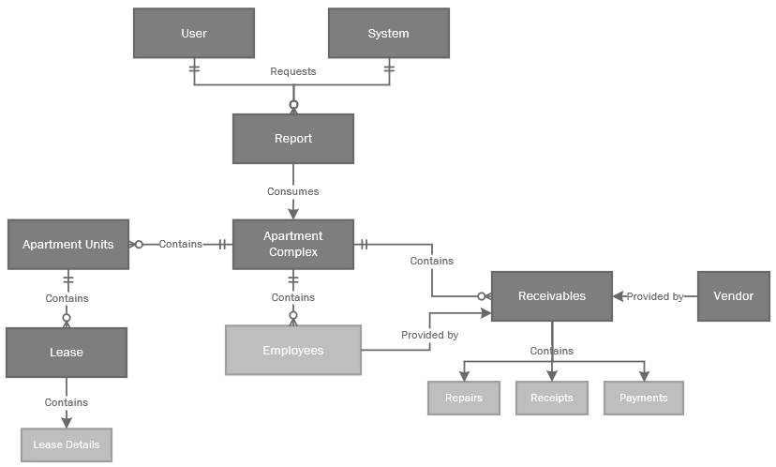
Enterprise Data Model
Used to represent how data is consumed, stored, used, and captured
Data model based on how Managers at HQ will interact with DB
Notes:
Used to represent how data is consumed, stored, used, and captured
The EDM is used to demonstrate architectural framework in a business enterprise.
EDMs could be used for target groups and to show how that specific department will utilize the DB.
Data model based on how managers at HQ will interact with DB
Reason this was chosen:
The main business requirement was to ensure quarterly reports are completed.
This was an opportunity to streamline the process and ensure corporate managers understand how to use the DB.
Corporate managers will be able to access the database and retrieve reports themselves.
Corporate managers need to understand how the data interacts within the system and what each entity contains.

Slide 14
Enterprise Data Model
Operating Rules for EDM
Set of rules that must be applied and maintained for DB to work as intended
Rules include:
HQ must have viewing permissions
DB must produce an automatic report
HQ managers will now access and retrieve the report
HQ may provide pre-authorization to administrators
Notes:
Set of rules that must be applied and maintained for DB to work as intended
Operating rules help focus what the EDM should operate on.
This also helps focus on streamlining and promoting efficiency in the business operations.
Rules include:
HQ must have viewing permissions
The permissions are for viewing the tables of: Apartment Complexes, Apartment Units, Employees, Leases, Receivables, and Vendor tables.
DB must produce an automatic report
Reports will have the capability of having the appropriate selections and filters applied.
For instance, if a manager needs a quarterly report on the receivables of Apartment Complex A, they should be able to apply these filters and generate that report.
HQ managers will now access and retrieve the report
In the past, Apartment Managers needed to submit the reports to HQ managers for review. Often, data was missing or not in a format that was conducive for Corporate managers. This caused dependencies in the process.
Now, they will be able to generate these reports themselves.
For ease, they can establish a database schedule for reports to generate to their designated secure portal every quarter at a certain time.
HQ may provide pre-authorization to administrators
In the times where Corporate managers are busy, they can assign pre-authorization to pull and prepare reports to trusted employees.

Slide 15
Law, Ethics, and Security

Slide 16
Laws, Ethics, and Security
Legal and Ethical Requirements
Legal Compliance
Governmental and industry regulations (i.e., HIPAA)
Local and federal laws in Apartment Complex locations (i.e., CA, ID, OR, WA)
Fair Housing Act (FHA)
Tenant Laws
Rent Control
Ethical Protocols and Practices
Respect User Privacy
Protection of Data
Transparent Uses and Disclosures
Notes:
Legal Compliance
Governmental and industry regulations (i.e., HIPAA)
Local and federal laws in Apartment Complex locations (i.e., CA, ID, OR, WA)
Wild Wood Apartments DB will consider the laws and regulations at local, state, and federal levels.
For instance, in California, it is important to consider the California Consumer Privacy Act (CCPA) and ensure that tenant’s personal information is not distributed in reports to unauthorized individuals. This is to ensure that the database design and operations continuously meet regulations regarding the collection of sensitive data, its usage, and the security surrounding it.
Fair Housing Act (FHA)
The Fair Housing Act (FHA) prohibits any form of discrimination against those underneath protected class statuses.
These classes include race, color, religion, sex, national origin, handicap, and familial status.
This is important to consider because when storing this information, database users may record this information in the database but should never use this information against someone’s application for a rental property.
The same will also go towards those with criminal backgrounds or convictions. This information may be stored in the database but should ensure that policies, rules, and practices follow legal compliances regarding criminal screening.
Tenant Laws
The database will contain data that may or may not support consistent tenancy in apartment complexes, but should always abide by the law.
For instance, the California Tenant Protection Act of 2019 contains a segment that states that “Just Cause Termination” will not attach to tenant units where a tenant was lawfully and continuously occupying a residential property for 12 months.
This pertains to the database because the database stores information on when rental invoices were completed, delivered, and fulfilled to the tenants.
Based on this law, the database must continuously document all historical rental invoices based on the tenant’s occupancy in a specific rental unit.
Rent Control
The issue of rent and price increases must always be well-documented to prove no illegal activities are being committed by the Wild Wood Apartments.
The database will monitor any control or changes that may occur, especially in terms of rent increases and invoice documentation.
For instance, in California, there is a California Tenant Protection Act of 2019 (Assembly Bill 1482) that states that any annual rent increases must always be capped at 5 percent – plus inflation – for all buildings that are 15 years or older.
This will translate to the database in that permissions and documentation from the Wild Wood Apartments’ corporate legal team must be submitted before any changes to rent are made for apartment units.
Ethical Protocols and Practices
Respect User Privacy
Data and information privacy and protection revolves around the collection, usage, and access of the data, along with the data user’s legal right to it. This includes (but is not limited to):
o Private data should never be accessed by unauthorized personnel.
o Data should never be inappropriately used.
o The collection of data through technology about a person, entity, or corporation should always be accurate and complete.
o Data content should always be available to the data subject and promote ownership of their data.
o Users will always have the right to update, inspect, or correct these data.
Protection of Data
One of the key principles that Wild Wood Apartments will do for all external stakeholders (i.e., tenants, vendors) will be to only collect data necessary for legal contracts, agreements, and leases.
For instance, legal first and last names will need to be disclosed to complete contracts, but demographics such as race, ethnicity, weight, and height are all voluntary or unnecessary information to provide to Apartment Managers and/or Apartment Assistants during the data collection or interview process.
Database will only store information in a secure, encrypted storage that is password-protected.
Transparent Uses and Disclosures
The Wild Wood Apartments database and its uses will follow the basic principles of ensuring that any use of the data collected is defined and disclosed to all stakeholders.
Confidential release statements provided to tenants will designate exactly how the information will be stored in the database, how the data will be used (as applicable), and all authorized individuals who can view and access the information.

Slide 17
Laws, Ethics, and Security
Security Management Plan
Protection of workstations and physical machines
Encrypted transmission of data
Periodic audits and consistent monitoring for:
User Authentication
Security Systems
Database program and system
Personal login accounts and strong passwords
Routine server backups
Automatic Documentation
Mandatory, all-staff Bi-Annual Trainings
Notes:
Protection of workstations and physical machines
Computer workstations will contain antivirus programs and network encryption to ensure no unauthorized program accesses DB.
All workstations will have up-to-date firewall and instruction detection/prevention systems.
Encrypted transmission of data
Secure email portals will be used within and outside of the corporate location.
All transmissions between systems will encrypt the data so that information is not intercepted and interpreted during transmission.
Periodic audits and consistent monitoring for:
User Authentication
Security Systems
Database program and system
Personal login accounts and strong passwords
All tenant, applicants, or managers will have to create an account on a secure web exchange.
All passwords must contain numbers, letters, and special characters, but should not be a password from your10 previously used passwords.
Passwords will automatically reset every 60 days to ensure a new password is created.
Routine server backups
Database applications like Microsoft SQL Server are third-party programs that routinely are updated with new features, add-ons, or applications.
The DBA will review the database to ensure that the program did not download any malicious software, while also disabling or removing any features that are unnecessary to business operations.
The DBA will also check to ensure that the system is consistently up-to-date and patched appropriately as many system patches contain updated coding that helps strengthen vulnerabilities in the system.
Automatic Documentation
Every action and movement within the database will be recorded.
This record or change history will document the action, field change, time, and user account associated with the change and will help with auditing purposes.
Mandatory, all-staff Bi-Annual Trainings
The Bi-Annual Training will include instructing, educating, and reminding all personnel of the importance of database security, information protection, and data security.
This will also cover strict safety procedures (such as not containing any physical paperwork or notes at a workstation at any time) that will help mitigate these risks

Slide 18
FIN
Any questions?

